Slide 1
Acquiring Alzheimer’s Syndrome Detection through the Application of Machine Learning.
Name: Viraj shah
Student id: 2330079
Supervisor’s name: dr. Mahmud ahmed
Course: MSc in computer science

Slide 2
Introduction
Alzheimer's disease, a prevalent neurological ailment, holds profound significance within both the United Kingdom's healthcare system and the global healthcare landscape. Its historical impact on society underscores the pressing need for innovative research and enhanced diagnostic methods.
Machine learning leverages data analysis and pattern recognition to identify subtle cognitive changes and biomarkers in individuals. By analyzing large datasets, it can detect early signs of Alzheimer's disease, enabling timely intervention and potentially improving patient outcomes through early diagnosis and personalized treatment.

Slide 3
Contents
Aim & Objectives
Problem
Methods
Data Management
Results
Limitations
Future Work

Slide 4
AIM & OBJECTIVES
The main motive behind this research is to design & develop an accurate framework or architecture for the classification of Alzheimer’s Disease.
The overarching goal is to change the present strategy for treating neurodegenerative diseases by boosting the accuracy and minimizing the loss, to achieve f1-score and recall of the images for initial diagnoses while establishing unconventional approaches to healthcare.
Determining the possible applications of machine learning software that recognizes images advances for identifying diseases in a variety of medical environments. The goal delves into the ways this kind of tech could possibly be used to enhance the analytic methods in a larger volume.

Slide 5
PROBLEM
Due to the cognitive impact of Alzheimer's disease, a prompt diagnosis is crucial. However, the mild initial symptoms and the limitations of existing diagnostic approaches often result in delayed treatments and compromised outcomes.
Another hurdle involved developing a machine learning algorithm capable of reliably forecasting brain MRI scan results. This task includes not just algorithm design and training but also the critical aspect of ensuring its efficiency and scalability in managing the extensive dataset when processed.

Slide 6
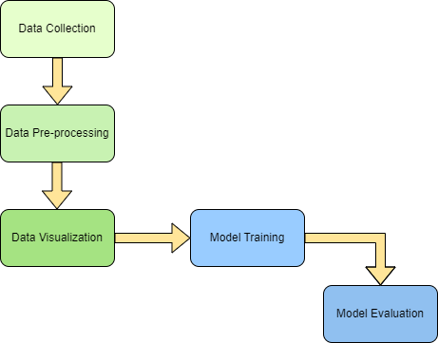
Methods
Data Collection
Dataset Pre processing
Data Visualization
Machine Learning Model Training
Model Evaluation

Slide 7
Data Management
Data Collection:
The dataset is obtained from Kaggle.
It is used as a primary source for the research on Early detection of Alzheimer Disease.
Data Pre-processing:
The scaling of the images is done to make sure the dataset has all the images with identical dimensions.
The images are divided into three sub-folders namely : training, testing and validation in a ratio of 80%, 10% and 10% respectively.

Slide 8
Data Management
Data Visualization:
After collecting the dataset, some sample images are depicted to have a idea on the how and what images are present in dataset.
Graphs are being shown after training the model to display the accuracy and loss of the data.

Slide 9
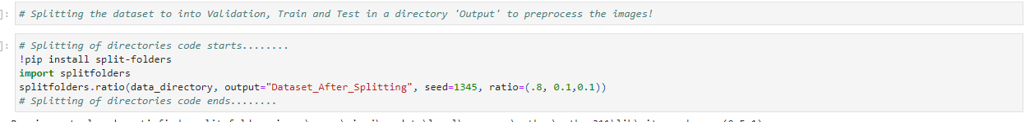
Test & Train
The dataset is divided into a directory named Dataset_After_Splitting and further divided into three sub directories: training, validation and testing set using the below code.

Slide 10
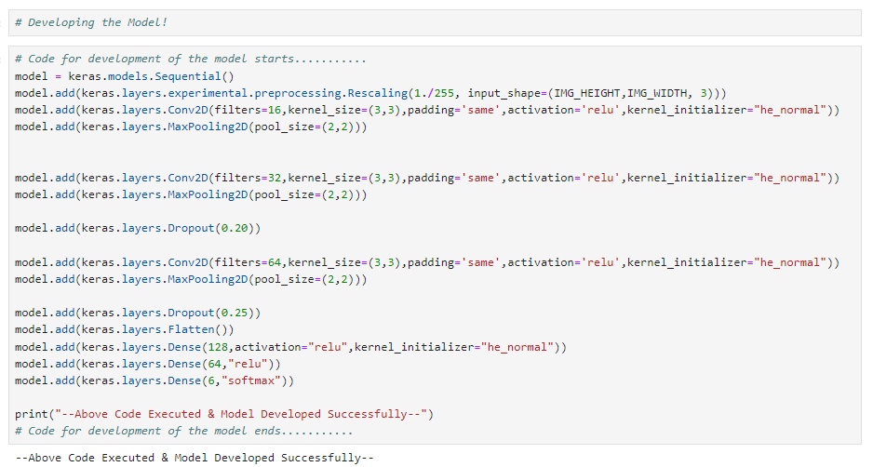
Customised Trained Model

Slide 11
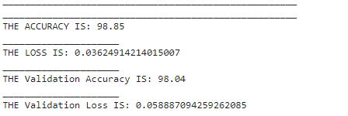
Results
The below screenshot depicts the results of the customized model. It shows the accuracy, loss, validation accuracy and validation loss of the training and validation set.

Slide 12
Limitations
The dataset used was limited in scope and size.
A large number of MRI scans of brain is required.
Only a specific number of algorithms were tested on the data.
An extensive testing on larger and more complex dataset is required.
More comprehensive data from different geographical regions is needed.
Thorough testing on different methods and hyperparameters needed to develop robust solutions.

Slide 13
Future Work
A Graphical User Interface can be developed for healthcare professionals
The GUI can potentially be easily integrated with machine learning methods, which leads to in accuracy levels that are equivalent to those of the trained model.
An MRI scans might be effortlessly uploaded by users, and the system will thereafter evaluate the image through comparing it to the model's training data in the background whereas the upload is being processed.
A prototype can be designed without any unnecessary complexities.

Slide 14
Thank You

